Slide 1
4
Continuous Random Variables and Probability Distributions
CHAPTER OUTLINE
4-1 Continuous Random Variables
4-2 Probability Distributions and Probability Density Functions
4-3 Cumulative Distribution Functions
4-4 Mean and Variance of a Continuous Random Variable
4-5 Continuous Uniform Distribution
4-6 Normal Distribution
4-7 Normal Approximation to the Binomial and Poisson Distributions
4-8 Exponential Distribution
4-9 Erlang and Gamma Distributions
4-10 Weibull Distribution
4-11 Lognormal Distribution
4-12 Beta Distribution

Slide 2
Learning Objectives for Chapter 4
After careful study of this chapter, you should be able to do the following:
Determine probabilities from probability density functions.
Determine probabilities from cumulative distribution functions, and cumulative distribution functions from probability density functions, and the reverse.
Calculate means and variances for continuous random variables.
Understand the assumptions for some common continuous probability distributions.
Select an appropriate continuous probability distribution to calculate probabilities for specific applications.
Calculate probabilities, determine means and variances for some common continuous probability distributions.
Standardize normal random variables.
Use the table for the cumulative distribution function of a standard normal distribution to calculate probabilities.
Approximate probabilities for some binomial and Poisson distributions.

Slide 3
Continuous Random Variables
The dimensional length of a manufactured part is subject to small variations in measurement due to vibrations, temperature fluctuations, operator differences, calibration, cutting tool wear, bearing wear, and raw material changes.
This length X would be a continuous random variable that would occur in an interval (finite or infinite) of real numbers.
The number of possible values of X, in that interval, is uncountably infinite and limited only by the precision of the measurement instrument.

Slide 4
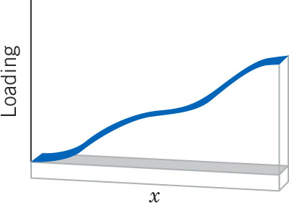
Continuous Density Functions
Density functions, in contrast to mass functions, distribute probability continuously along an interval.
The loading on the beam between points a & b is the integral of the function between points a & b.
Figure 4-1 Density function as a loading on a long, thin beam. Most of the load occurs at the larger values of x.

Slide 5
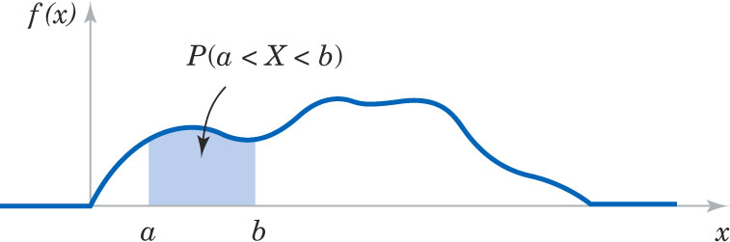
A probability density function f(x) describes the probability distribution of a continuous random variable. It is analogous to the beam loading.
Figure 4-2 Probability is determined from the area under f(x) from a to b.

Slide 6
Probability Density Function

Slide 7
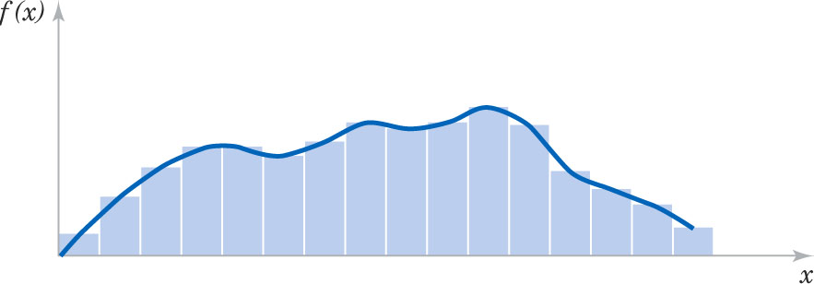
Histograms
A histogram is graphical display of data showing a series of adjacent rectangles. Each rectangle has a base which represents an interval of data values. The height of the rectangle creates an area which represents the relative frequency associated with the values included in the base.
A continuous probability distribution f(x) is a model approximating a histogram. A bar has the same area of the integral of those limits.
Figure 4-3 Histogram approximates a probability density function.

Slide 8
Area of a Point

Slide 9
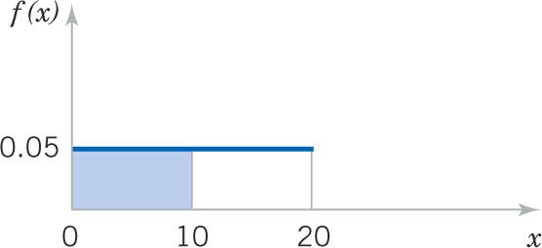
Example 4-1: Electric Current
Let the continuous random variable X denote the current measured in a thin copper wire in milliamperes (mA). Assume that the range of X is 0 ≤ x ≤ 20 and f(x) = 0.05. What is the probability that a current is less than 10mA?
Answer:
Figure 4-4 P(X < 10) illustrated.

Slide 10
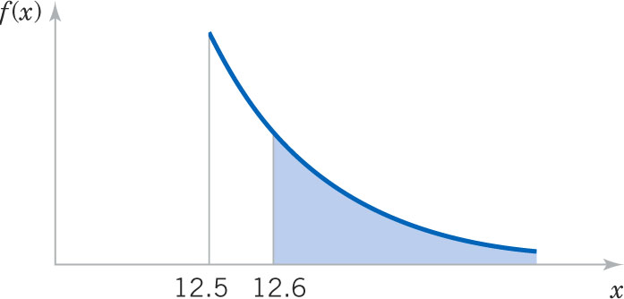
Example 4-2: Hole Diameter
Let the continuous random variable X denote the diameter of a hole drilled in a sheet metal component. The target diameter is 12.5 mm. Random disturbances to the process result in larger diameters. Historical data shows that the distribution of X can be modeled by f(x)= 20e^{-20(x-12.5)}, x ≥ 12.5 mm. If a part with a diameter larger than 12.60 mm is scrapped, what proportion of parts is scrapped?
Answer:

Slide 11
Cumulative Distribution Functions

Slide 12
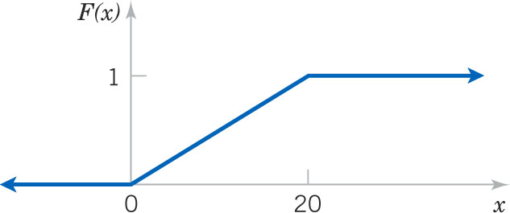
Example 4-3: Electric Current
For the copper wire current measurement in Exercise 4-1, the cumulative distribution function (CDF) consists of three expressions to cover the entire real number line.
Figure 4-6 This graph shows the CDF as a continuous function.

Slide 13
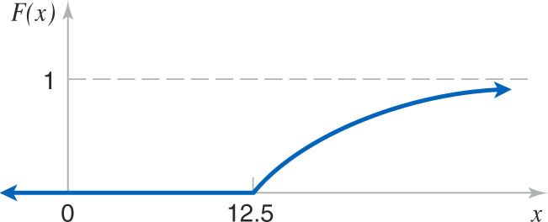
Example 4-4: Hole Diameter
For the drilling operation in Example 4-2, F(x) consists of two expressions. This shows the proper notation.
Figure 4-7 This graph shows F(x) as a continuous function.

Slide 14
Density vs. Cumulative Functions
The probability density function (PDF) is the derivative of the cumulative distribution function (CDF).
The cumulative distribution function (CDF) is the integral of the probability density function (PDF).

Slide 15
Exercise 4-5: Reaction Time
The time until a chemical reaction is complete (in milliseconds, ms) is approximated by this CDF:
What is the PDF?
What proportion of reactions is complete within 200 ms?

Slide 16
Mean & Variance

Slide 17
Example 4-6: Electric Current
For the copper wire current measurement in Exercise 4-1, the PDF is f(x) = 0.05 for 0 ≤ x ≤ 20. Find the mean and variance.

Slide 18
Mean of a Function of a Random Variable
Example 4-7: In Example 4-1, X is the current measured in mA. What is the expected value of the squared current?

Slide 19
Example 4-8: Hole Diameter
For the drilling operation in Example 4-2, find the mean and variance of X using integration by parts. Recall that f(x) = 20e^{-20(x-12.5)}dx for x ≥ 12.5.

Slide 20
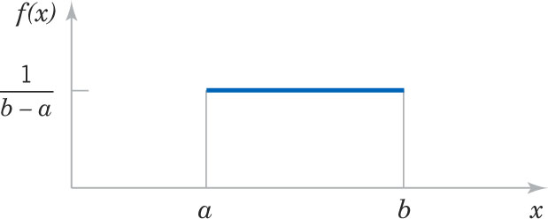
Continuous Uniform Distribution
This is the simplest continuous distribution and analogous to its discrete counterpart.
A continuous random variable X with probability density function
f(x) = 1 / (b-a) for a ≤ x ≤ b (4-6)
Figure 4-8 Continuous uniform PDF

Slide 21
Mean & Variance
Mean & variance are:
Derivations are shown in the text. Be reminded that b² - a² = (b + a)(b - a)

Slide 22
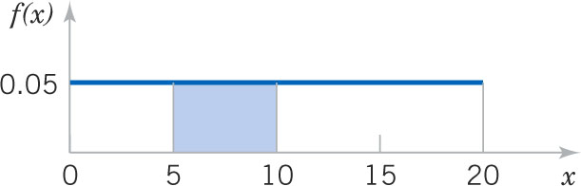
Example 4-9: Uniform Current
Let the continuous random variable X denote the current measured in a thin copper wire in mA. Recall that the PDF is F(x) = 0.05 for 0 ≤ x ≤ 20.
What is the probability that the current measurement is between 5 & 10 mA?
Figure 4-9

Slide 23
Continuous Uniform CDF
Figure 4-6 (again) Graph of the Cumulative Uniform CDF

Slide 24
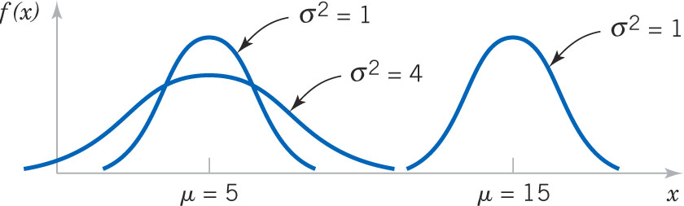
Normal Distribution
The most widely used distribution is the normal distribution, also known as the Gaussian distribution.
Random variation of many physical measurements are normally distributed.
The location and spread of the normal are independently determined by mean (μ) and standard deviation (σ).
Figure 4-10 Normal probability density functions

Slide 25
Normal Probability Density Function

Slide 26
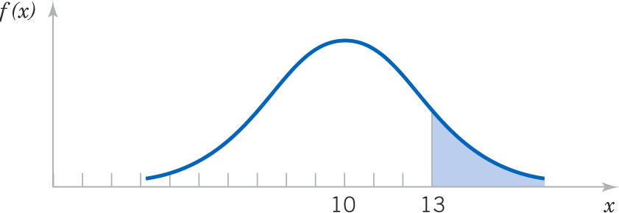
Example 4-10: Normal Application
Assume that the current measurements in a strip of wire follows a normal distribution with a mean of 10 mA & a variance of 4 mA². Let X denote the current in mA.
What is the probability that a measurement exceeds 13 mA?
Figure 4-11 Graphical probability that X > 13 for a normal random variable with μ = 10 and σ² = 4.

Slide 27
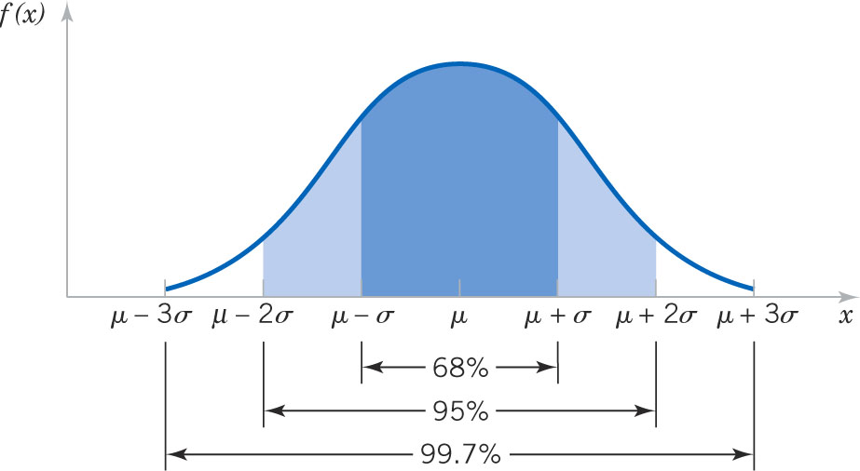
Empirical Rule
P(μ – σ < X < μ + σ) = 0.6827
P(μ – 2σ < X < μ + 2σ) = 0.9545
P(μ – 3σ < X < μ + 3σ) = 0.9973
Figure 4-12 Probabilities associated with a normal distribution – well worth remembering to quickly estimate probabilities.

Slide 28
Standard Normal Distribution
A normal random variable with
μ = 0 and σ² = 1
Is called a standard normal random variable and is denoted as Z. The cumulative distribution function of a standard normal random variable is denoted as:
Φ(z) = P(Z ≤ z) = F(z)
Values are found in Appendix Table III and by using Excel and Minitab.

Slide 29
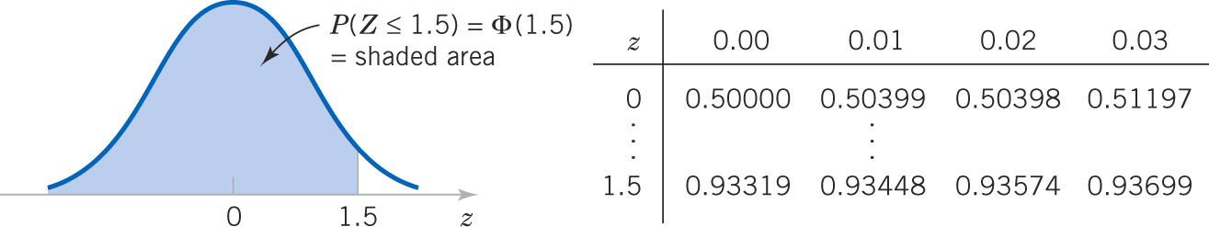
Example 4-11: Standard Normal Distribution
Assume Z is a standard normal random variable.
Find P(Z ≤ 1.50). Answer: 0.93319
Find P(Z ≤ 1.53). Answer: 0.93699
Find P(Z ≤ 0.02). Answer: 0.50398
Figure 4-13 Standard normal PDF

Slide 30
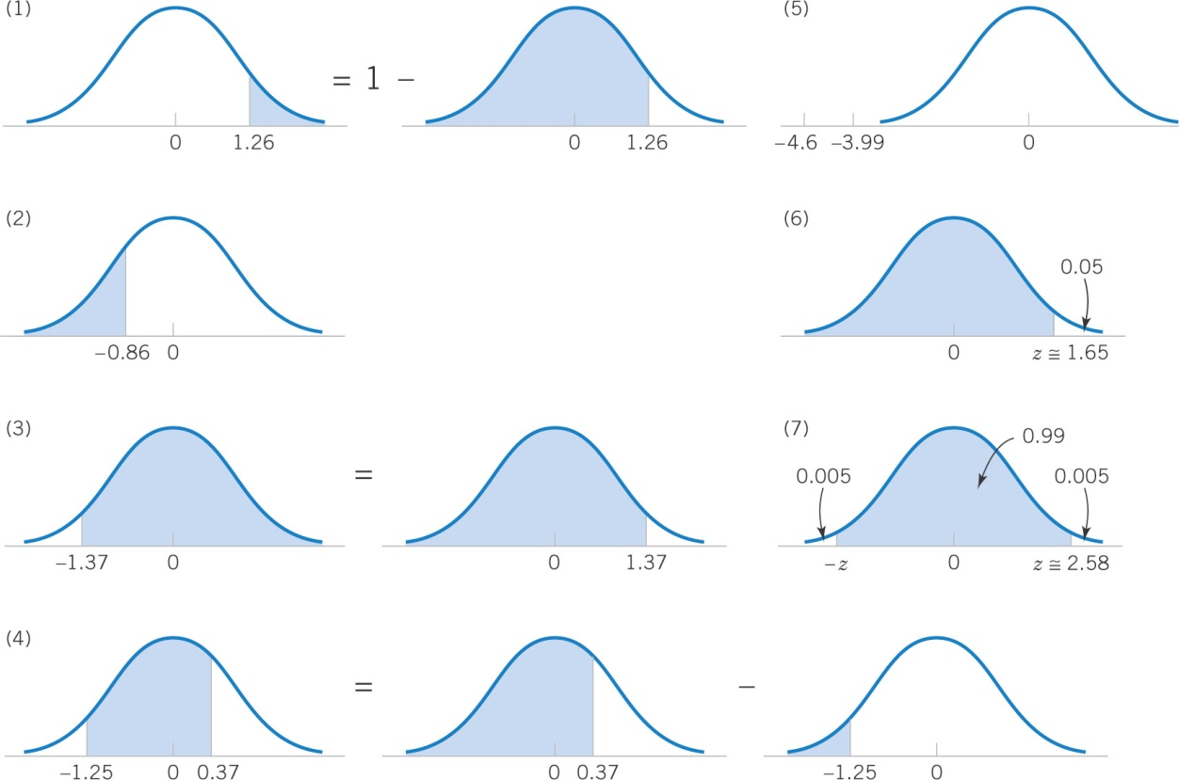
Example 4-12: Standard Normal Exercises
P(Z > 1.26) = 0.1038
P(Z < -0.86) = 0.195
P(Z > -1.37) = 0.915
P(-1.25 < 0.37) = 0.5387
P(Z ≤ -4.6) ≈ 0
Find z for P(Z ≤ z) = 0.05, z = -1.65
Find z for (-z < Z < z) = 0.99, z = 2.58
Figure 4-14 Graphical displays for standard normal distributions.

Slide 31
Standardizing

Slide 32
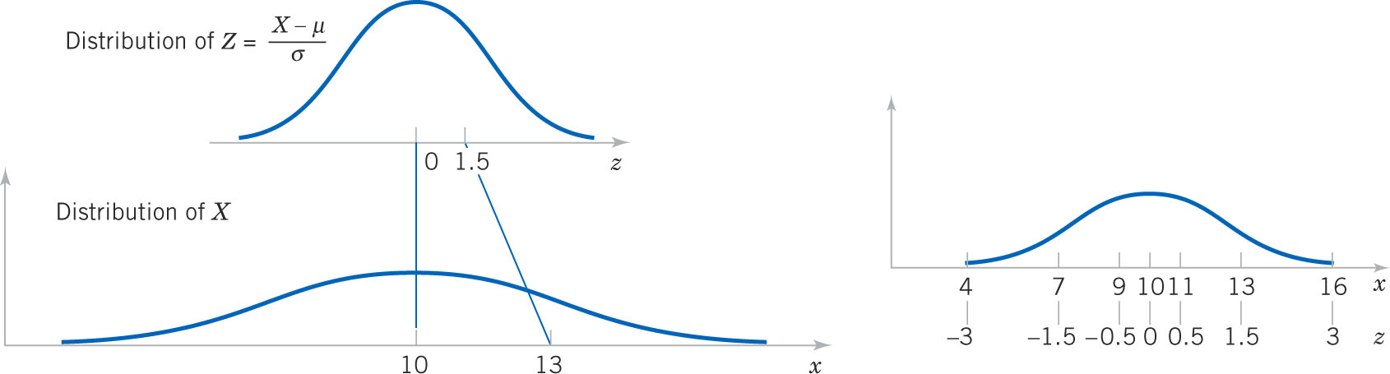
Example 4-14: Normally Distributed Current-1
From a previous example with μ = 10 and σ = 2 mA, what is the probability that the current measurement is between 9 and 11 mA?
Answer:
Figure 4-15 Standardizing a normal random variable.

Slide 33
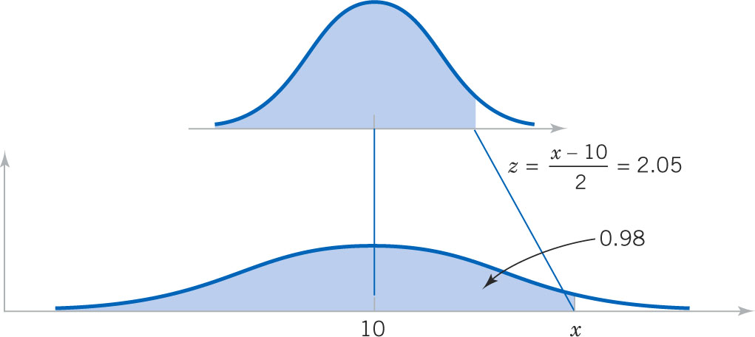
Example 4-14: Normally Distributed Current-2
Determine the value for which the probability that a current measurement is below this value is 0.98.
Answer:
Figure 4-16 Determining the value of x to meet a specified probability.

Slide 34
Example 4-15: Signal Detection-1
Assume that in the detection of a digital signal, the background noise follows a normal distribution with μ = 0 volt and σ = 0.45 volt. The system assumes a signal 1 has been transmitted when the voltage exceeds 0.9. What is the probability of detecting a digital 1 when none was sent? Let the random variable N denote the voltage of noise.
This probability can be described as the probability of a false detection.

Slide 35
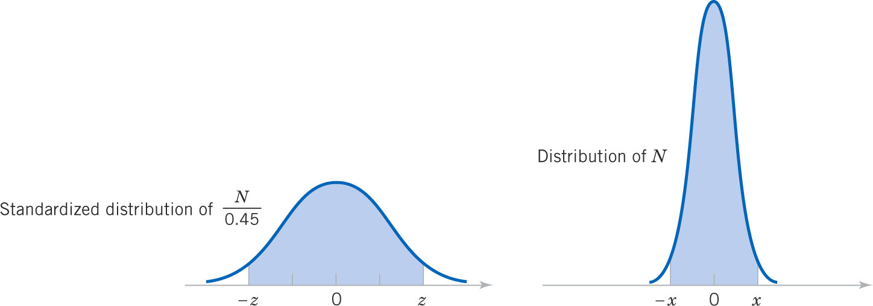
Example 4-15: Signal Detection-2
Determine the symmetric bounds about 0 that include 99% of all noise readings. We need to find x such that P(-x < N < x) = 0.99.
Figure 4-17 Determining the value of x to meet a specified probability.

Slide 36
Example 4-15: Signal Detection-3
Suppose that when a digital 1 signal is transmitted, the mean of the noise distribution shifts to 1.8 volts. What is the probability that a digital 1 is not detected? Let S denote the voltage when a digital 1 is transmitted.
This probability can be interpreted as the probability of a missed signal.

Slide 37
Example 4-16: Shaft Diameter-1
The diameter of the shaft is normally distributed with μ = 0.2508 inch and σ = 0.0005 inch. The specifications on the shaft are 0.2500 ± 0.0015 inch. What proportion of shafts conform to the specifications? Let X denote the shaft diameter in inches.
Answer:

Slide 38
Example 4-16: Shaft Diameter-2
Most of the nonconforming shafts are too large, because the process mean is near the upper specification limit. If the process is centered so that the process mean is equal to the target value, what proportion of the shafts will now conform?
Answer:
By centering the process, the yield increased from 91.924% to 99.730%, an increase of 7.806%

Slide 39
Normal Approximations
The binomial and Poisson distributions become more bell-shaped and symmetric as their means increase.
For manual calculations, the normal approximation is practical – exact probabilities of the binomial and Poisson, with large means, require technology (Minitab, Excel).
The normal is a good approximation for the:
Binomial if np > 5 and n(1-p) > 5.
Poisson if λ > 5.

Slide 40
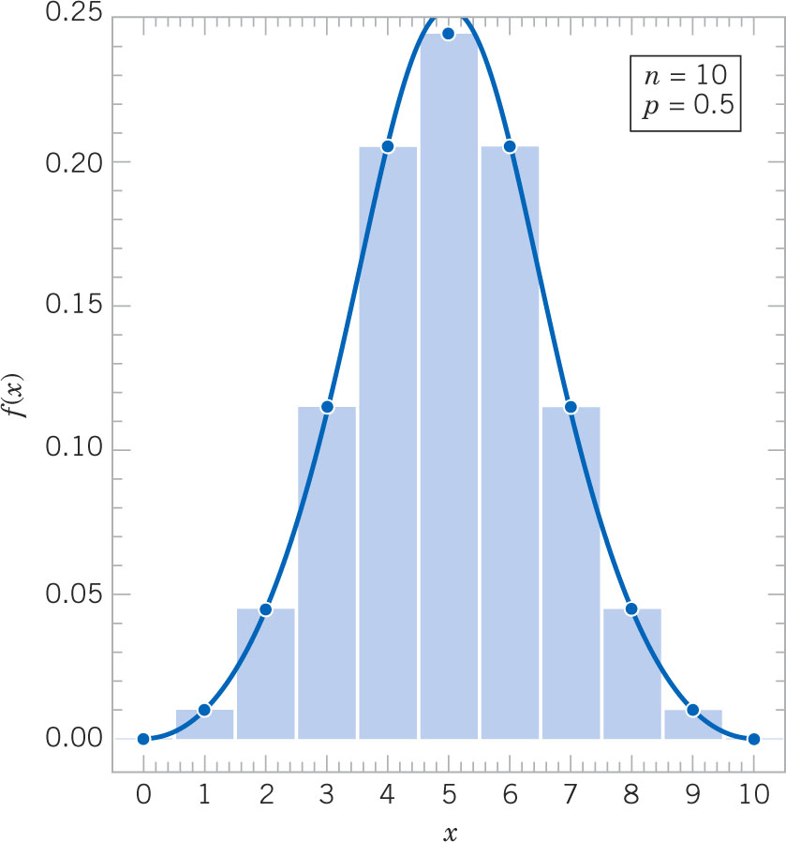
Normal Approximation to the Binomial
Suppose we have a binomial distribution with n = 10 and p = 0.5. Its mean and standard deviation are 5.0 and 1.58 respectively.
Draw the normal distribution over the binomial distribution.
The areas of the normal approximate the areas of the bars of the binomial with a continuity correction.
Figure 4-19 Overlaying the normal distribution upon a binomial with matched parameters.

Slide 41
Example 4-17:
In a digital comm channel, assume that the number of bits received in error can be modeled by a binomial random variable. The probability that a bit is received in error is 10⁻⁵. If 16 million bits are transmitted, what is the probability that 150 or fewer errors occur? Let X denote the number of errors.
Answer:
Can only be evaluated with technology. Manually, we must use the normal approximation to the binomial.

Slide 42
Normal Approximation Method

Slide 43
Example 4-18: Applying the Approximation
The digital comm problem in the previous example is solved using the normal approximation to the binomial as follows:

Slide 44
Example 4-19: Normal Approximation-1
Again consider the transmission of bits. To judge how well the normal approximation works, assume n = 50 bits are transmitted and the probability of an error is p = 0.1. The exact and approximated probabilities are:

Slide 45
Example 4-19: Normal Approximation-2

Slide 46
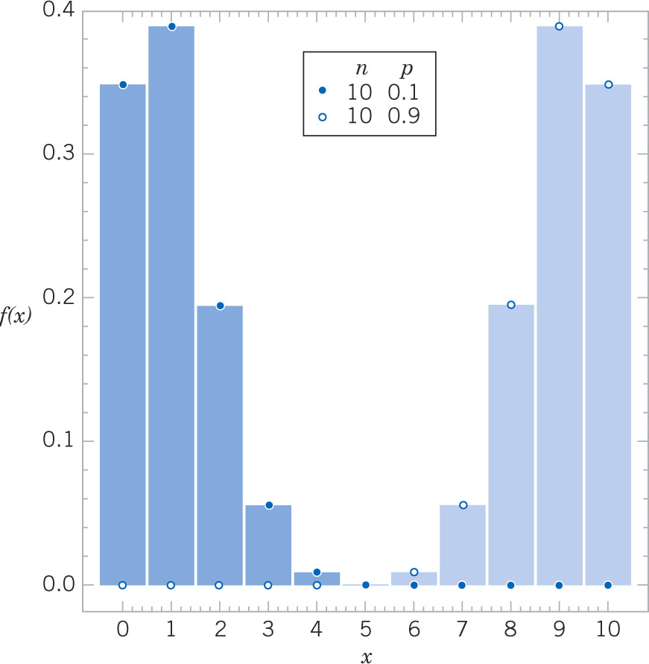
Reason for the Approximation Limits
The np > 5 and n(1-p) > 5 approximation rule is needed to keep the tails of the normal distribution from getting out-of-bounds.
As the binomial mean approaches the endpoints of the range of x, the standard deviation must be small enough to prevent overrun.
Figure 4-20 shows the asymmetric shape of the binomial when the approximation rule is not met.
Figure 4-20 Binomial distribution is not symmetric as p gets near 0 or 1.

Slide 47
Normal Approximation to Hypergeometric
Recall that the hypergeometric distribution is similar to the binomial such that p = K / N and when sample sizes are small relative to population size.
Thus the normal can be used to approximate the hypergeometric distribution also.

Slide 48
Normal Approximation to the Poisson

Slide 49
Example 4-20: Normal Approximation to Poisson
Assume that the number of asbestos particles in a square meter of dust on a surface follows a Poisson distribution with a mean of 100. If a square meter of dust is analyzed, what is the probability that 950 or fewer particles are found?

Slide 50
Exponential Distribution
The Poisson distribution defined a random variable as the number of flaws along a length of wire (flaws per mm).
The exponential distribution defines a random variable as the interval between flaws (mm’s between flaws – the inverse).

Slide 51
Exponential Distribution Definition
The random variable X that equals the distance between successive events of a Poisson process with mean number of events λ > 0 per unit interval is an exponential random variable with parameter λ. The probability density function of X is:
f(x) = λe^{-λx} for 0 ≤ x <  (4-14)

Slide 52
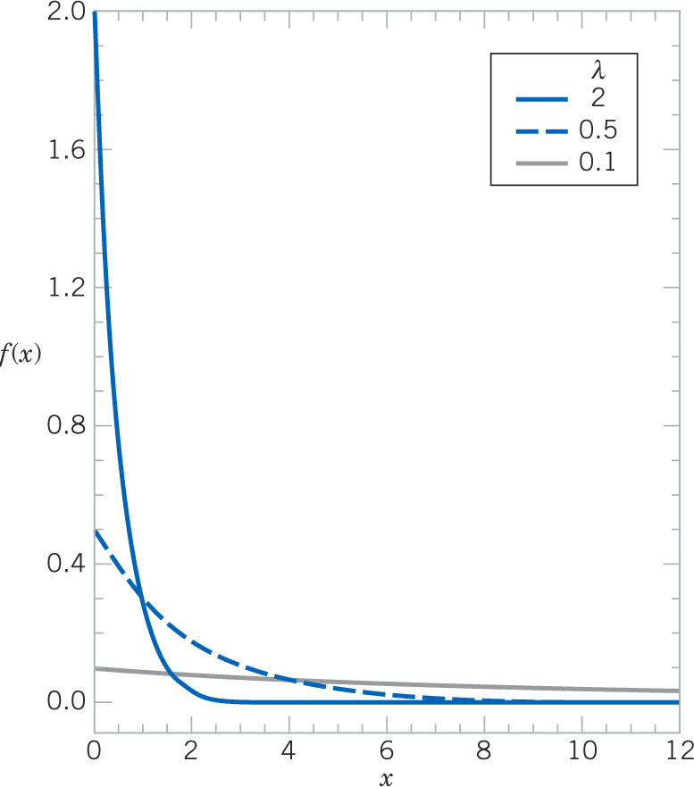
Exponential Distribution Graphs
The y-intercept of the exponential probability density function is λ.
The random variable is non-negative and extends to infinity.
F(x) = 1 – e^{-λx} is well-worth committing to memory – it is used often.
Figure 4-22 PDF of exponential random variables of selected values of λ.

Slide 53
Exponential Mean & Variance
Note that, for the:
Poisson distribution, the mean and variance are the same.
Exponential distribution, the mean and standard deviation are the same.

Slide 54
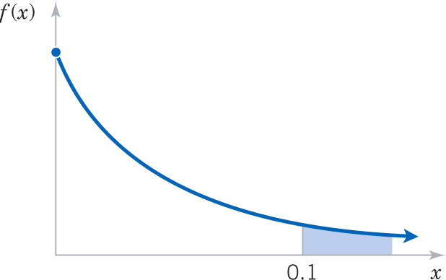
Example 4-21: Computer Usage-1
In a large corporate computer network, user log-ons to the system can be modeled as a Poisson process with a mean of 25 log-ons per hour. What is the probability that there are no log-ons in the next 6 minutes (0.1 hour)? Let X denote the time in hours from the start of the interval until the first log-on.
Figure 4-23 Desired probability.

Slide 55
Example 4-21: Computer Usage-2
Continuing, what is the probability that the time until the next log-on is between 2 and 3 minutes (0.033 & 0.05 hours)?

Slide 56
Example 4-21: Computer Usage-3
Continuing, what is the interval of time such that the probability that no log-on occurs during the interval is 0.90?
What is the mean and standard deviation of the time until the next log-in?

Slide 57
Characteristic of a Poisson Process
The starting point for observing the system does not matter.
The probability of no log-in in the next 6 minutes [P(X > 0.1 hour) = 0.082], regardless of whether:
A log-in has just occurred or
A log-in has not occurred for the last hour.
A system may have different means:
High usage period , e.g., λ = 250 per hour
Low usage period, e.g., λ = 25 per hour

Slide 58
Example 4-22: Lack of Memory Property
Let X denote the time between detections of a particle with a Geiger counter. Assume X has an exponential distribution with E(X) = 1.4 minutes. What is the probability that a particle is detected in the next 30 seconds?
No particle has been detected in the last 3 minutes. Will the probability increase since it is “due”?
No, the probability that a particle will be detected depends only on the interval of time, not its detection history.

Slide 59
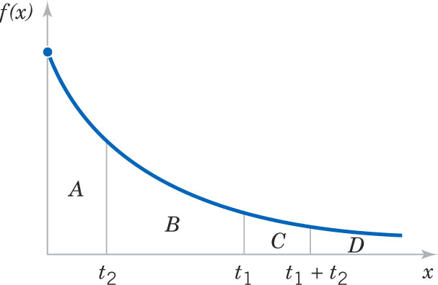
Lack of Memory Property
Areas A+B+C+D=1
A = P(X < t₂)
A+B+C = P(X<t₁+t₂)
C = P(X<t₁+t₂  X>t₁)
C+D = P(X>t₁)
C/(C+D) = P(X<t₁+t₂|X>t₁)
A = C/(C+D)
Figure 4-24 Lack of memory property of an exponential distribution.

Slide 60
Exponential Application in Reliability
The reliability of electronic components is often modeled by the exponential distribution. A chip might have mean time to failure of 40,000 operating hours.
The memoryless property implies that the component does not wear out – the probability of failure in the next hour is constant, regardless of the component age.
The reliability of mechanical components do have a memory – the probability of failure in the next hour increases as the component ages. The Weibull distribution is used to model this situation.

Slide 61
Erlang & Gamma Distributions
The Erlang distribution is a generalization of the exponential distribution.
The exponential models the interval to the 1st event, while the Erlang models the interval to the r^{th} event, i.e., a sum of exponentials.
If r is not required to be an integer, then the distribution is called gamma.
The exponential, as well as its Erlang and gamma generalizations, is based on the Poisson process.

Slide 62
Example 4-23: Processor Failure
The failures of CPUs of large computer systems are often modeled as a Poisson process. Assume that units that fail are repaired immediately and the mean number of failures per hour is 0.0001. Let X denote the time until 4 failures occur. What is the probability that X exceed 40,000 hours?
Let the random variable N denote the number of failures in 40,000 hours. The time until 4 failures occur exceeds 40,000 hours iff the number of failures in 40,000 hours is ≤ 3.

Slide 63
Erlang Distribution
Generalizing from the prior exercise:

Slide 64
Gamma Function
The gamma function is the generalization of the factorial function for r > 0, not just non-negative integers.

Slide 65
Gamma Distribution
The random variable X with a probability density function:
has a gamma random distribution with parameters λ > 0 and r > 0. If r is an positive integer, then X has an Erlang distribution.

Slide 66
Mean & Variance of the Gamma
If X is a gamma random variable with parameters λ and r,
μ = E(X) = r / λ and σ² = V(X) = r / λ² (4-19)
r and λ work together to describe the shape of the gamma distribution.

Slide 67
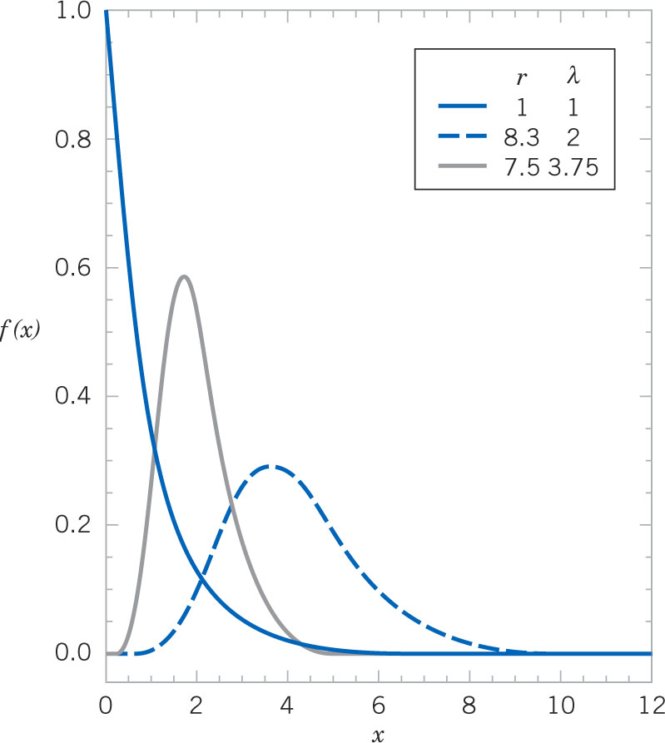
Gamma Distribution Graphs
The λ and r parameters are often called the “shape” and “scale”, but may take on different meanings.
Different parameter combinations change the distribution.
The distribution becomes symmetric as r (and μ) increases.
Figure 4-25 Gamma probability density functions for selected values of λ and r.

Slide 68
Example 4-24: Gamma Application-1
The time to prepare a micro-array slide for high-output genomics is a Poisson process with a mean of 2 hours per slide. What is the probability that 10 slides require more than 25 hours?
Let X denote the time to prepare 10 slides. Because of the assumption of a Poisson process, X has a gamma distribution with λ = ½, r = 10, and the requested probability is P(X > 25).
Using the Poisson distribution, let the random variable N denote the number of slides made in 10 hours. The time until 10 slides are made exceeds 25 hours iff the number of slides made in 25 hours is ≤ 9.
Using the gamma distribution, the same result is obtained.

Slide 69
Example 4-24: Gamma Application-2
What is the mean and standard deviation of the time to prepare 10 slides?

Slide 70
Example 4-24: Gamma Application-3
The slides will be completed by what length of time with 95% probability? That is: P(X ≤ x) = 0.95
Minitab: Graph > Probability Distribution Plot > View Probability

Slide 71
Chi-Squared Distribution
The chi-squared distribution is a special case of the gamma distribution with
λ = 1/2
r = ν/2 where ν (nu) = 1, 2, 3, …
ν is called the “degrees of freedom”.
The chi-squared distribution is used in interval estimation and hypothesis tests as discussed in Chapter 7.

Slide 72
Weibull Distribution
The Weibull distribution is often used to model the time until failure for physical systems in which failures:
Increase over time (bearings)
Decrease over time (some semiconductors)
Remain constant over time (subject to external shock)
Parameters provide flexibility to reflect an item’s failure experience or expectation.

Slide 73
Weibull PDF

Slide 74
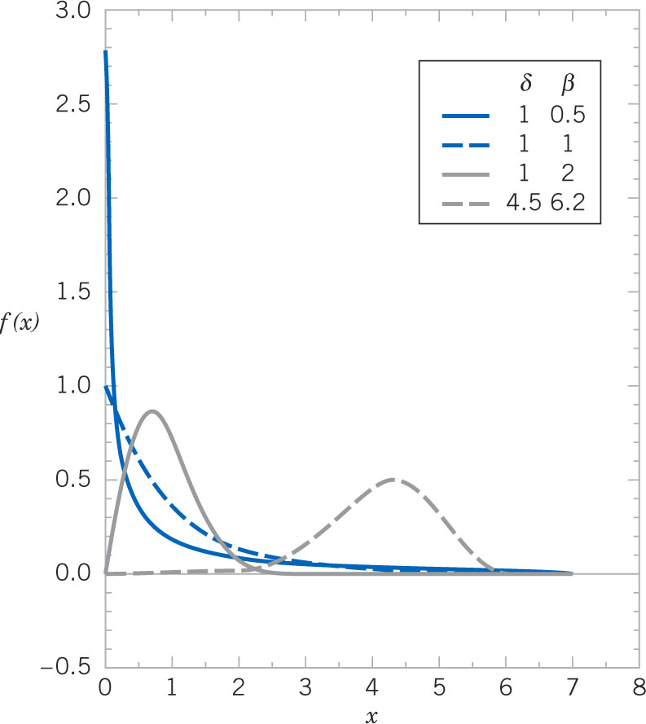
Weibull Distribution Graphs
Added slide
Figure 4-26 Weibull probability density function for selected values of δ and β.

Slide 75
Example 4-25: Bearing Wear
The time to failure (in hours) of a bearing in a mechanical shaft is modeled as a Weibull random variable with β = ½ and δ = 5,000 hours.
What is the mean time until failure?
What is the probability that a bearing will last at least 6,000 hours? (error in text solution)

Slide 76
Lognormal Distribution
Let W denote a normal random variable with mean of θ and variance of ω², i.e., E(W) = θ and V(W) = ω²
As a change of variable, let X = e^{W} = exp(W) and W = ln(X)
Now X is a lognormal random variable.

Slide 77
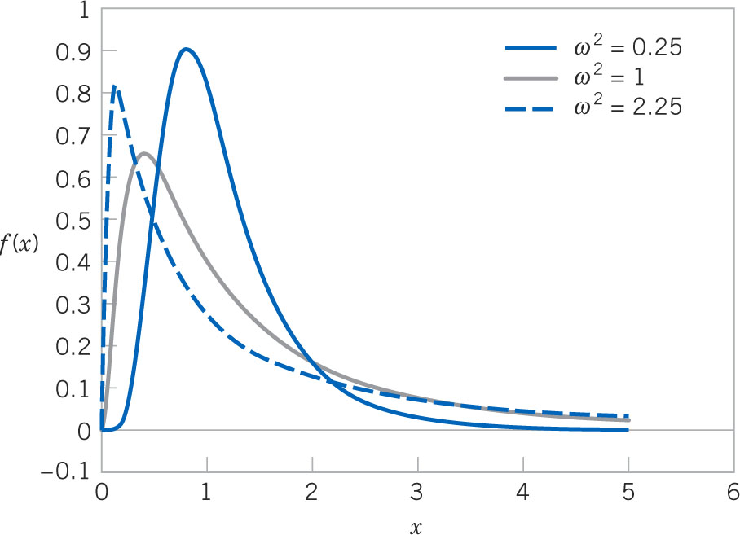
Lognormal Graphs
Figure 4-27 Lognormal probability density functions with θ = 0 for selected values of ω².

Slide 78
Example 4-27: Semiconductor Laser-1
The lifetime of a semiconductor laser has a lognormal distribution with θ = 10 and ω = 1.5 hours.
What is the probability that the lifetime exceeds 10,000 hours?

Slide 79
Example 4-27: Semiconductor Laser-2
What lifetime is exceeded by 99% of lasers?
What is the mean and variance of the lifetime?

Slide 80
Beta Distribution
A continuous distribution that is flexible, but bounded over the [0, 1] interval is useful for probability models. Examples are:
Proportion of solar radiation absorbed by a material.
Proportion of the max time to complete a task.

Slide 81
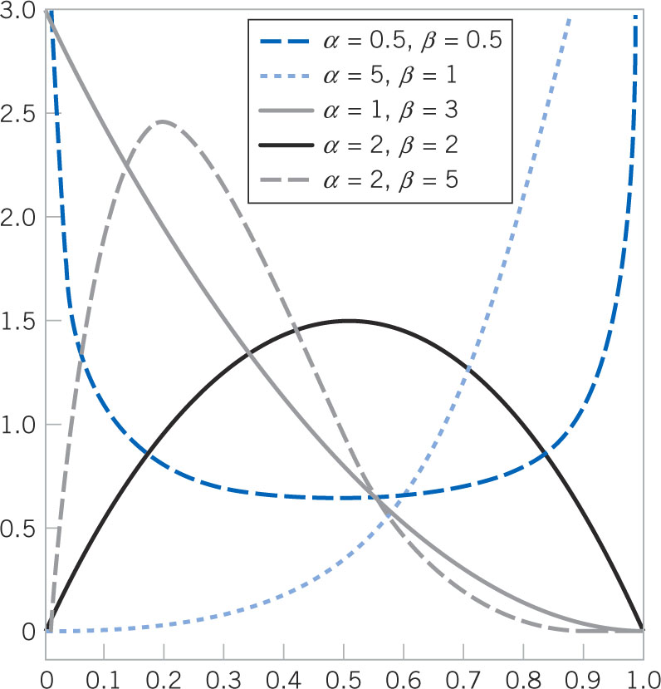
Beta Shapes Are Flexible
Distribution shape guidelines:
If α = β, symmetrical about x = 0.5.
If α = β = 1, uniform.
If α = β < 1, symmetric & U- shaped.
If α = β > 1, symmetric & mound-shaped.
If α ≠ β, skewed.
Figure 4-28 Beta probability density functions for selected values of the parameters α and β.

Slide 82
Example 4-27: Beta Computation-1
Consider the completion time of a large commercial real estate development. The proportion of the maximum allowed time to complete a task is a beta random variable with α = 2.5 and β = 1. What is the probability that the proportion of the max time exceeds 0.7? Let X denote that proportion.

Slide 83
Example 4-27: Beta Computation-2
This Minitab graph illustrates the prior calculation. FIX

Slide 84
Mean & Variance of the Beta Distribution
If X has a beta distribution with parameters α and β,
Example 4-28: In the prior example, α = 2.5 and β = 1. What are the mean and variance of this distribution?

Slide 85
Mode of the Beta Distribution
If α >1 and β > 1, then the beta distribution is mound-shaped and has an interior peak, called the mode of the distribution. Otherwise, the mode occurs at an endpoint.

Slide 86
Extended Range for the Beta Distribution
The beta random variable X is defined for the [0, 1] interval. That interval can be changed to [a, b]. Then the random variable W is defined as a linear function of X:
W = a + (b –a)X
With mean and variance:
E(W) = a + (b –a)E(X)
V(W) = (b-a)²V(X)

Slide 87
Important Terms & Concepts of Chapter 4
Beta distribution
Chi-squared distribution
Continuity correction
Continuous uniform distribution
Cumulative probability distribution for a continuous random variable
Erlang distribution
Exponential distribution
Gamma distribution
Lack of memory property of a continuous random variable
Lognormal distribution
Mean for a continuous random variable
Mean of a function of a continuous random variable
Normal approximation to binomial & Poisson probabilities
Normal distribution
Probability density function
Probability distribution of a continuous random variable
Standard deviation of a continuous random variable
Standardizing
Standard normal distribution
Variance of a continuous random variable
Weibull distribution

